Slide 1
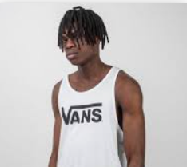
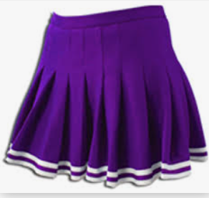
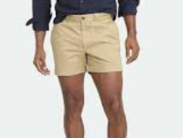
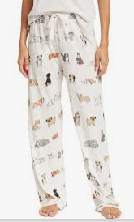
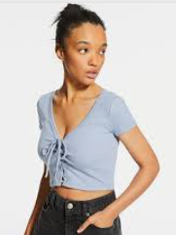
What not to wear…
Tank Tops& Midriffs
Gun, drugs, sexual references or obscenities
Short Shorts
Short Skirts
Pajama Pants
Notes:
Remind them no holes in pants/jeans are permitted above the knee.

